Slide 1
MISSION UPDATES
OCTOBER 2025

Slide 2
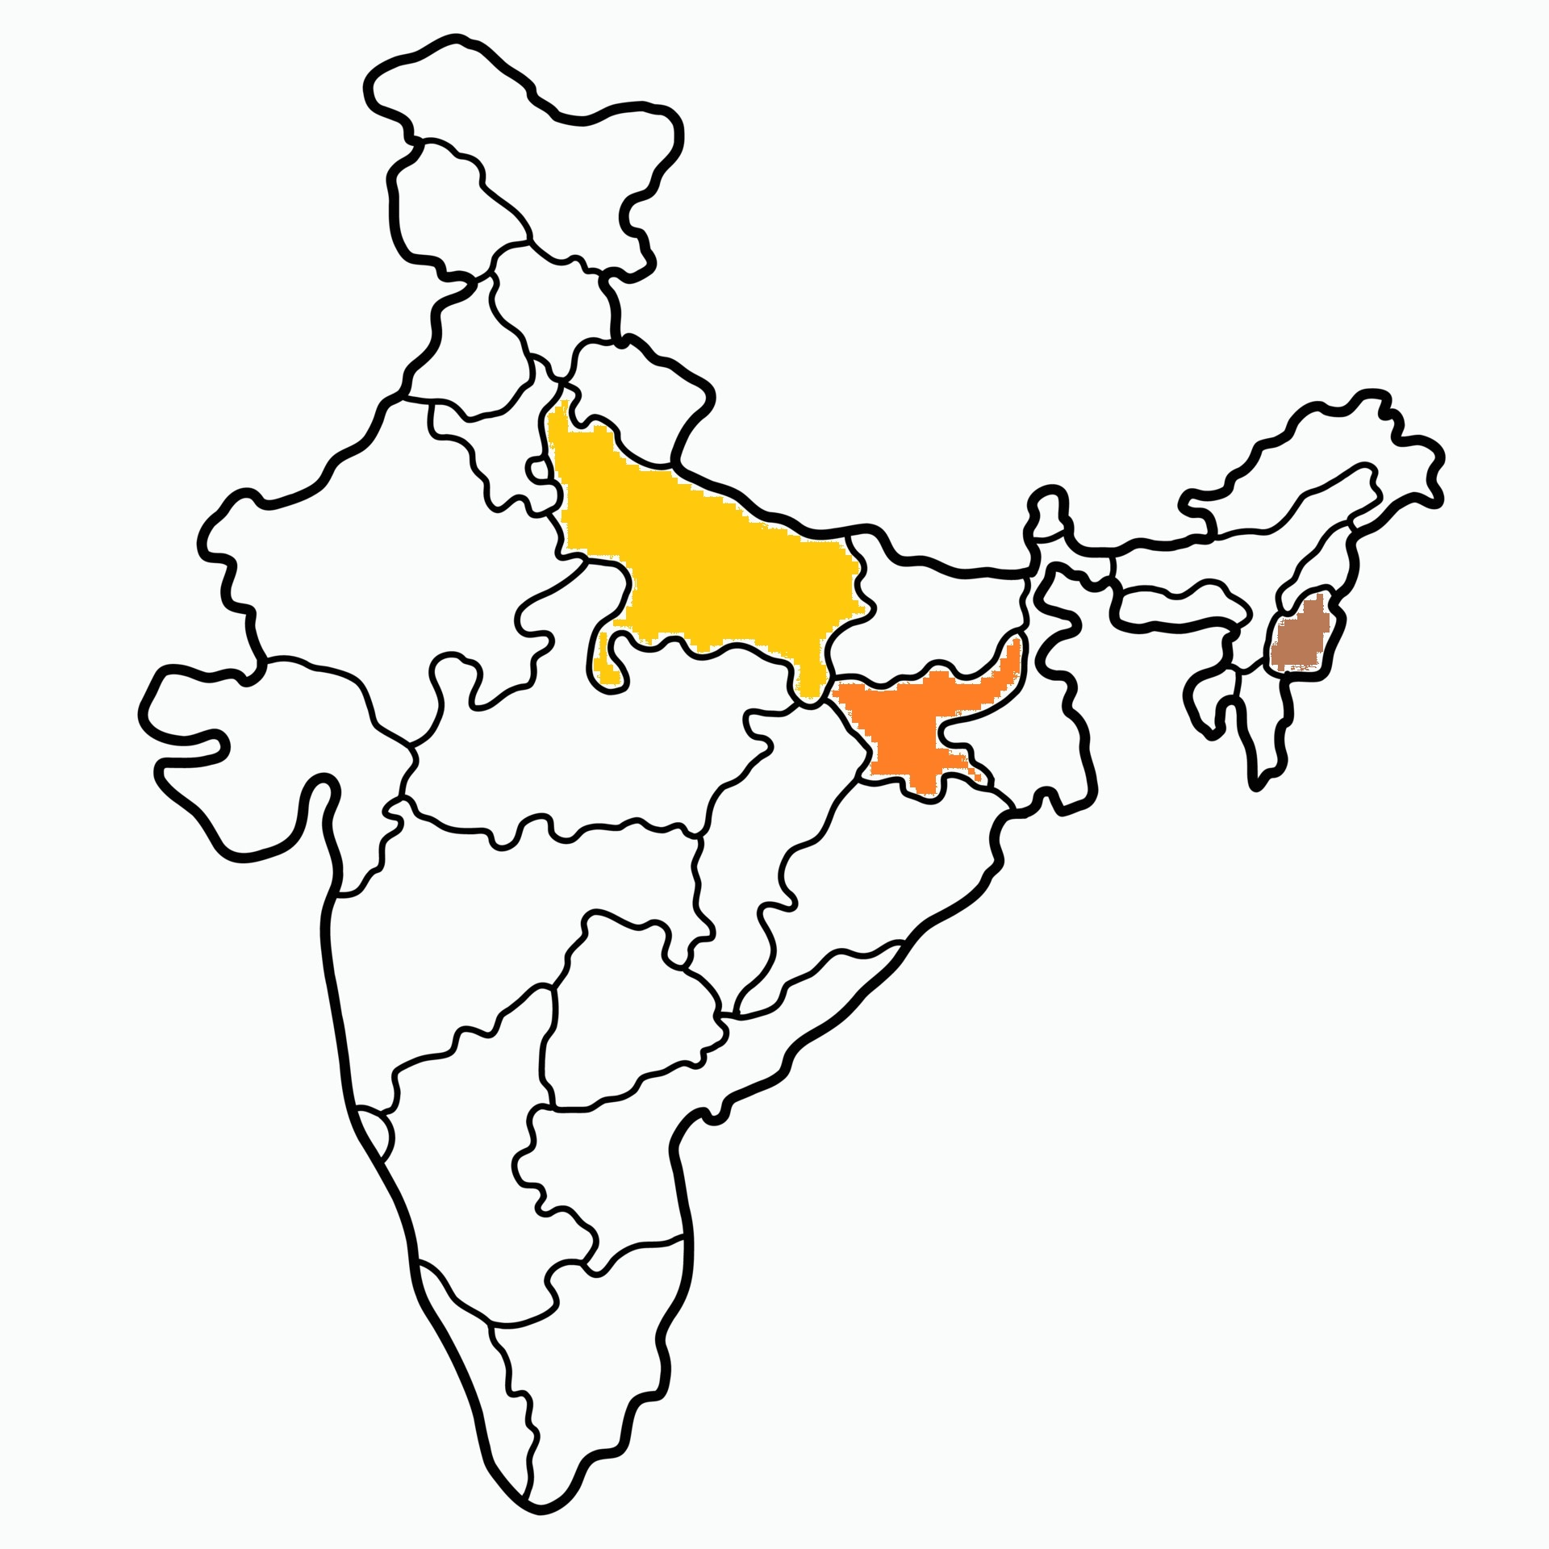

Slide 3
Mission Stations
10 mission stations supported in Jharkhand.
5 mission stations supported in U.P.
1 ICPF workstation supported in North-east India.

Slide 4
NORTH INDIA MISSION
UP
Pr. Sunny George
5 Stations
Jharkhand
Pr. Sam
10 Stations
ICPF
Dr. James George
1 Station

Slide 5
U.P.

Slide 6
Last Month -
5 people came to know the Lord.
Several others are preparing to take water baptism.

Slide 7
Prayer Requests
The opposition in UP is becoming more intense. Pray earnestly for the ministry in U.P.
Please pray for Pastor Vidya Sagar Prasad, who is suffering from coronary artery disease.

Slide 8
Jharkhand

Slide 9
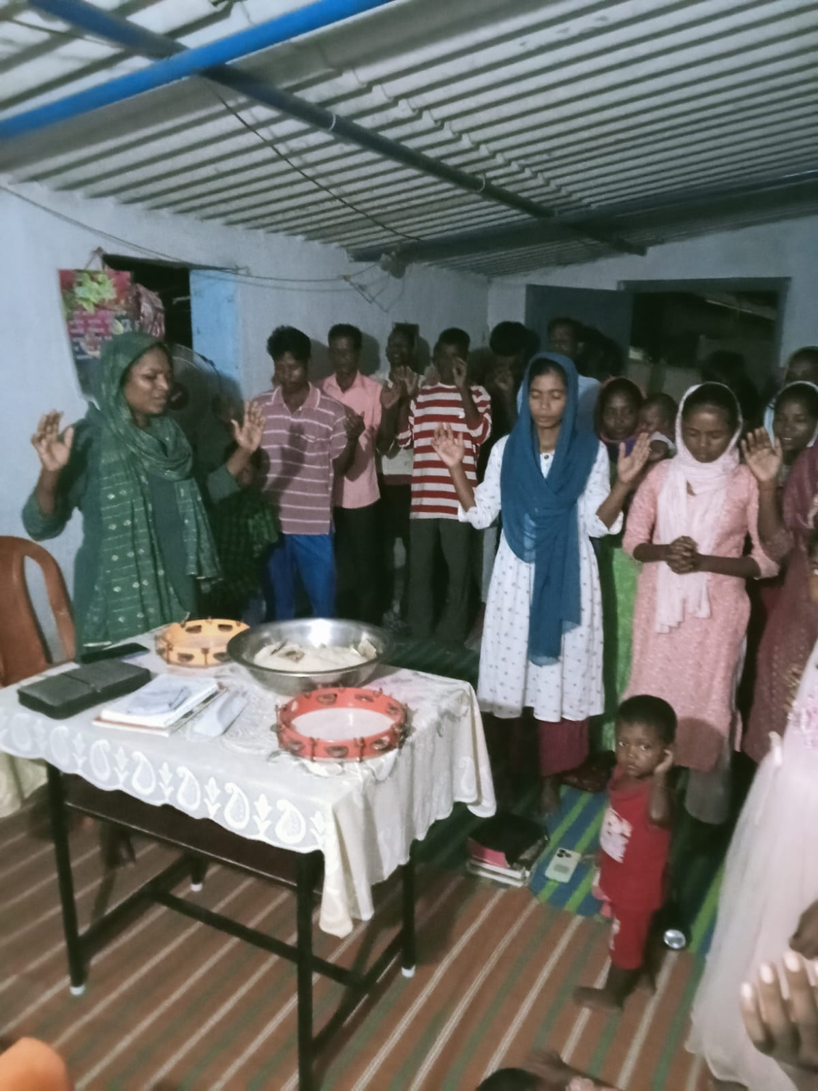
Village Ministry
Meeting with the believers.

Slide 10
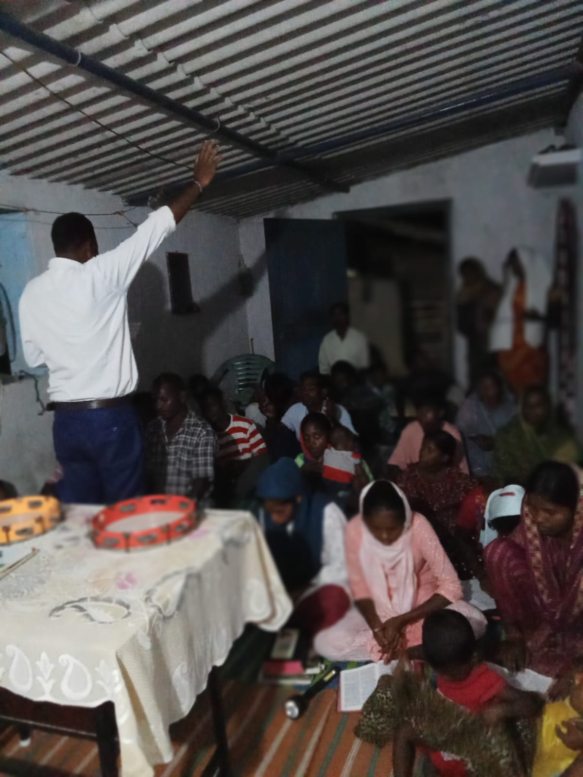

Slide 11
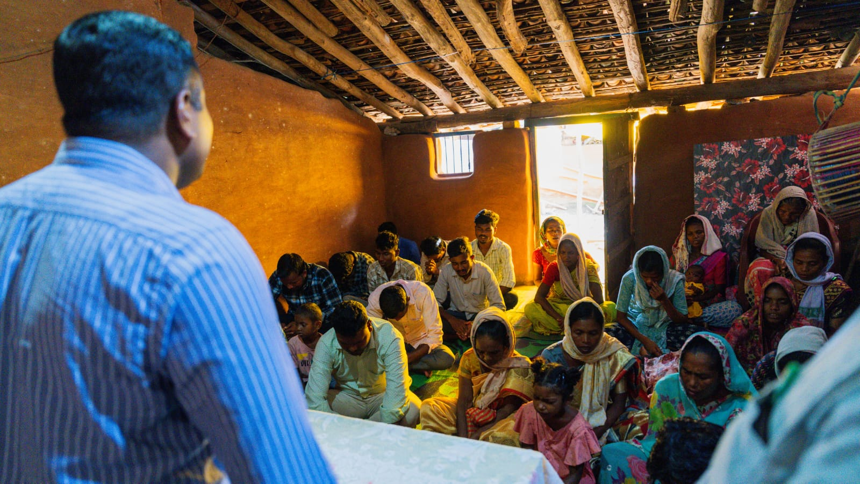

Slide 12
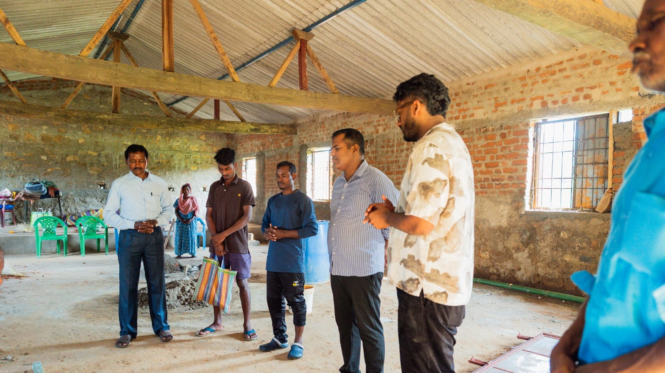
Church Construction – praying for completion of the work

Slide 13
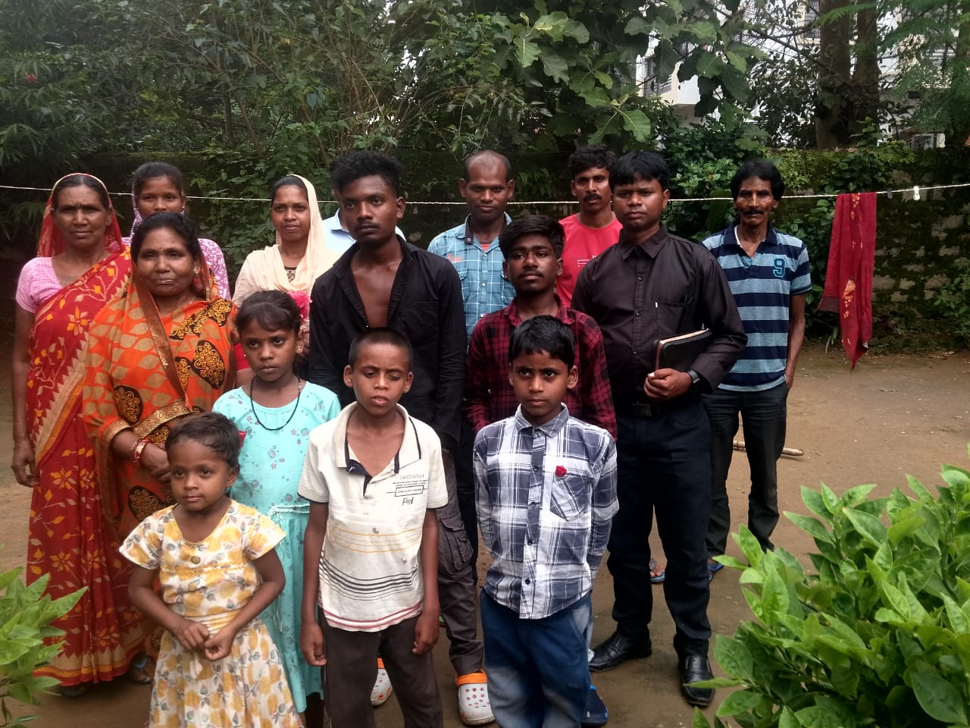
This Church is being persecuted.
Water, electricity and ration not provided in the village.
Please pray for them.

Slide 14
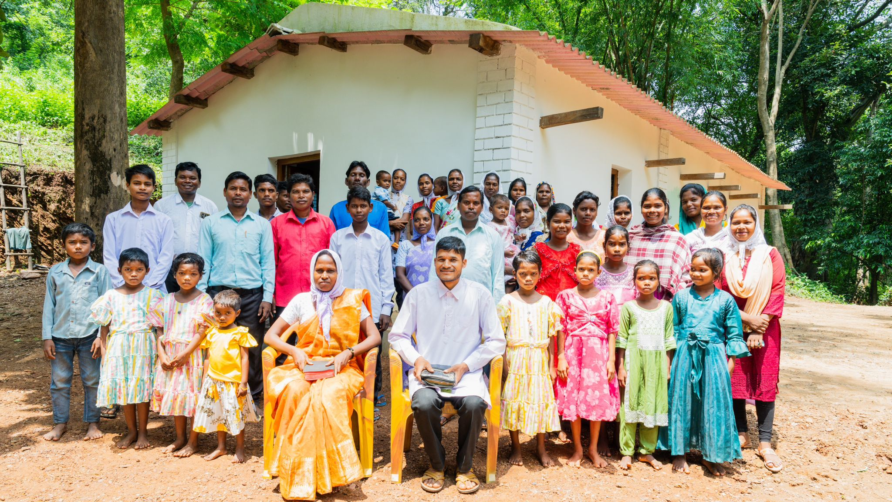
Church building completed

Slide 15
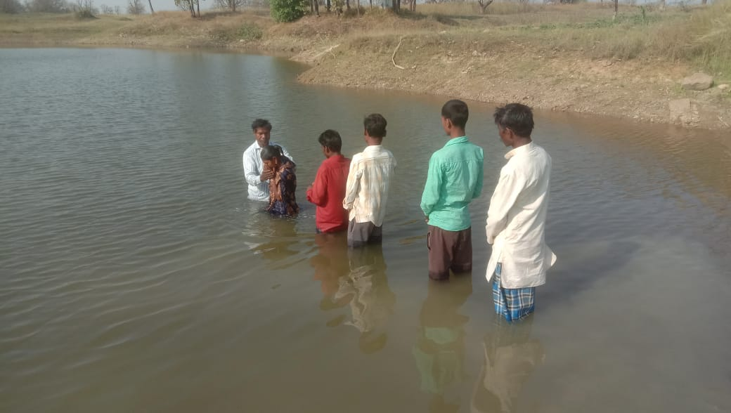
Baptisms

Slide 16
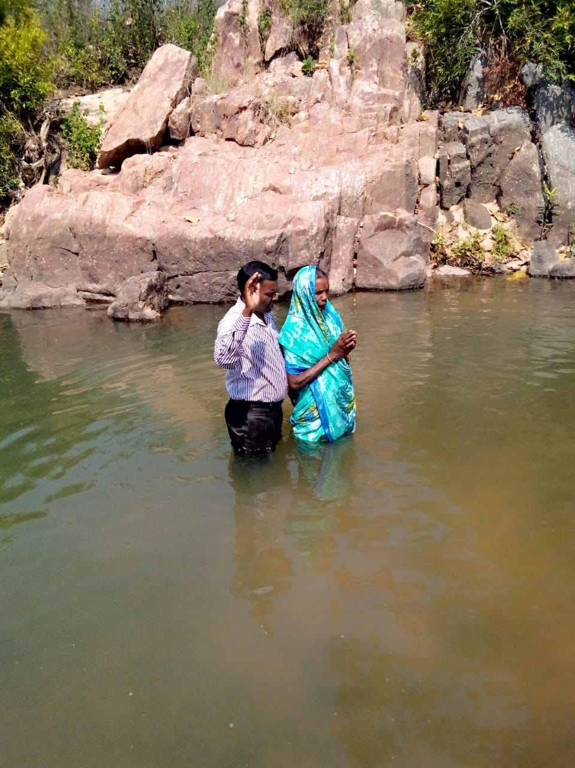

Slide 17
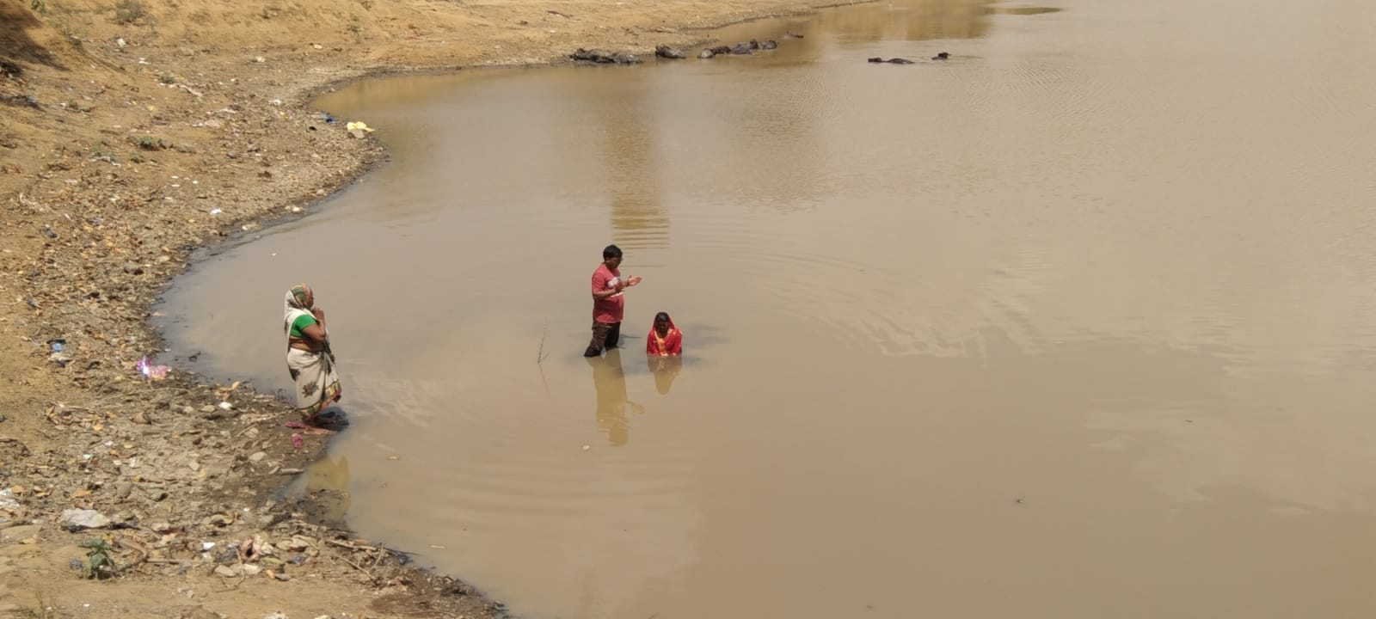

Slide 18
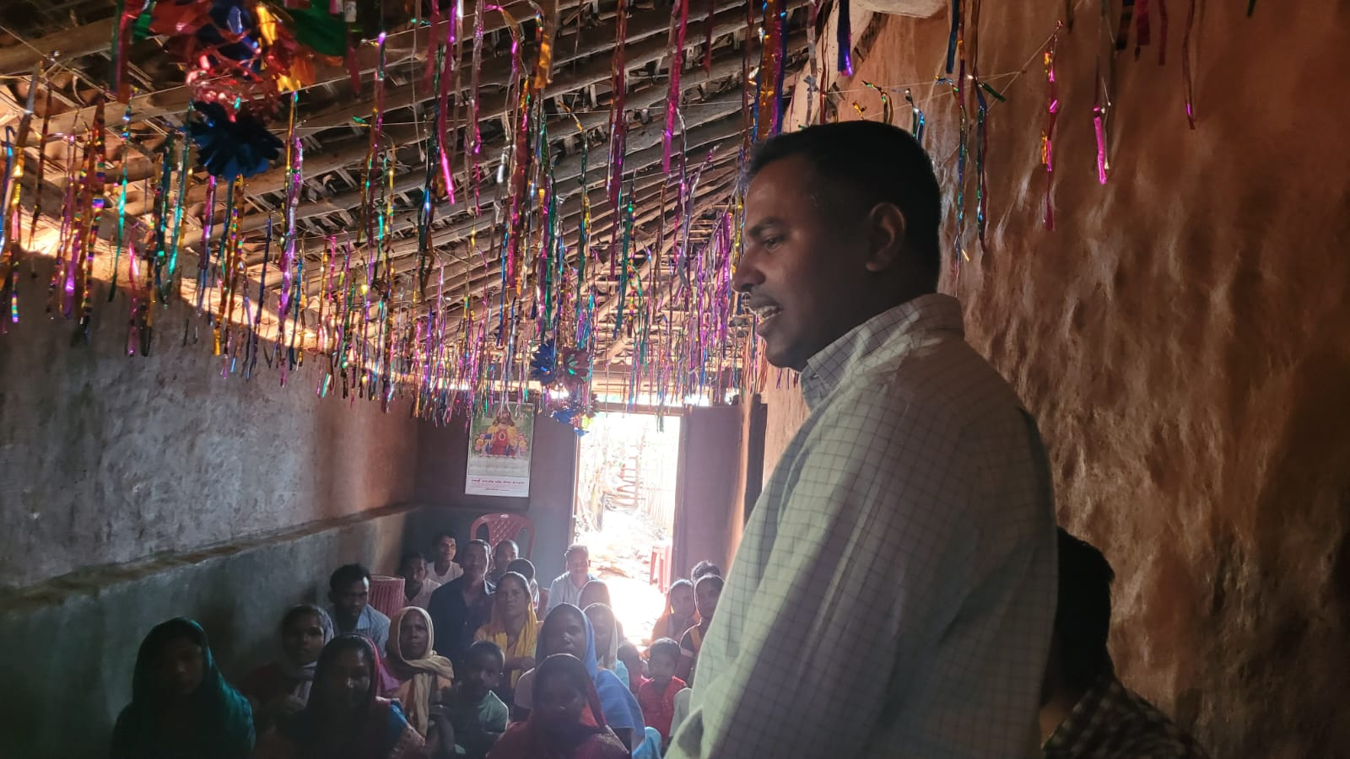

Slide 19
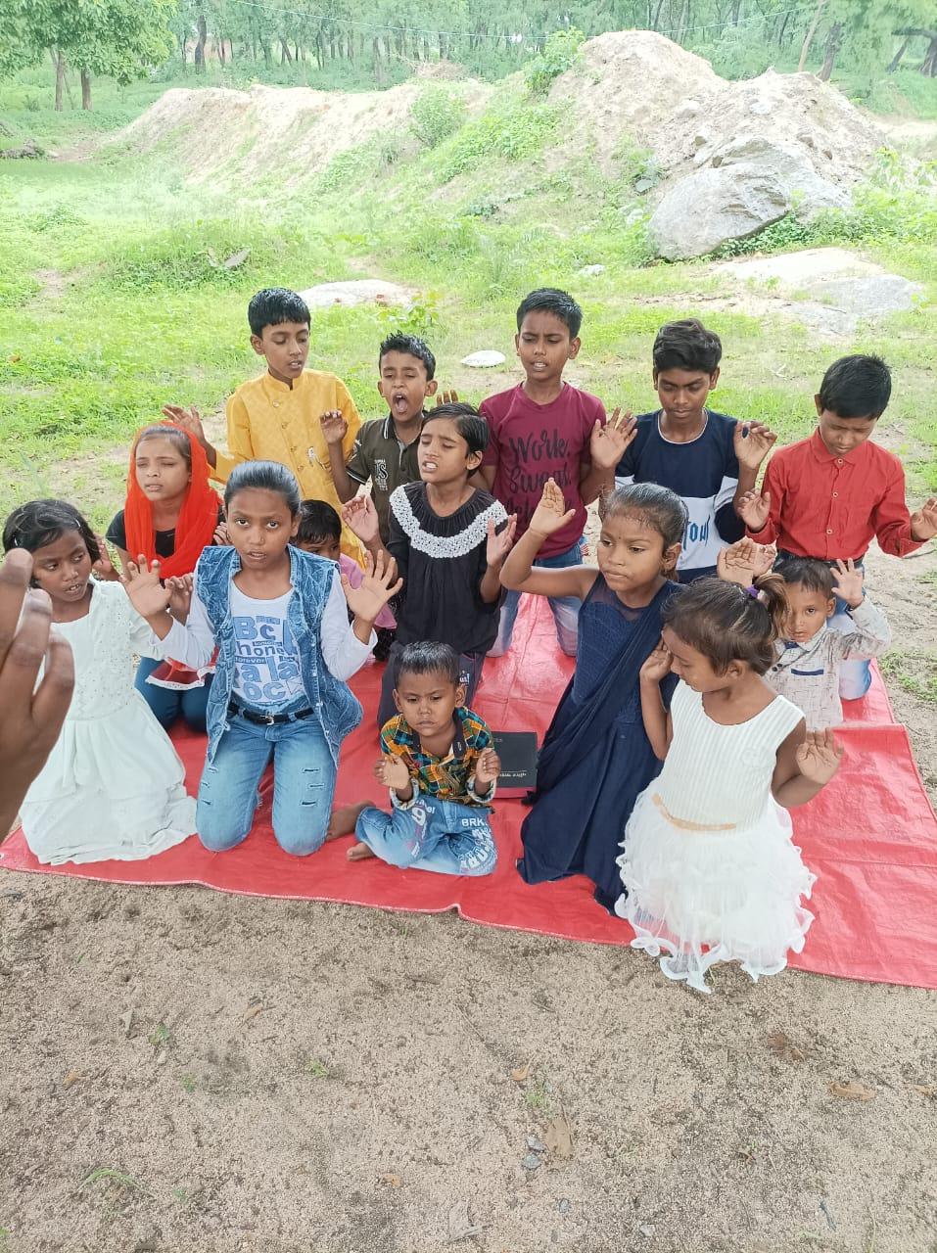

Slide 20
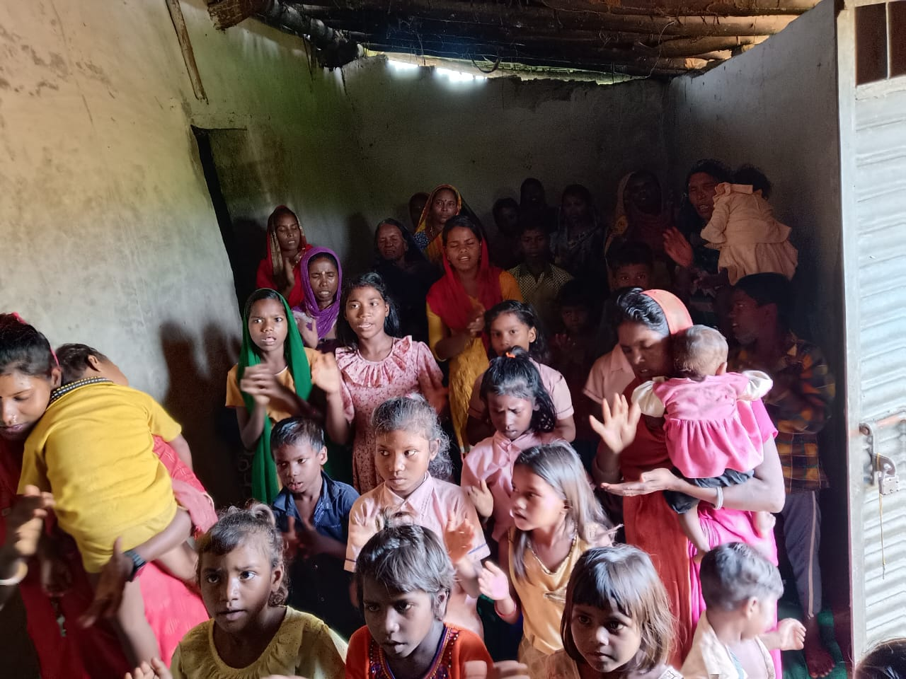

Slide 21
Thank You

